Slide 1

Clustering Assignment - HELP International
Submitted by Anurag James Singh

Slide 2
PROBLEM STATEMENT
To categorize the countries using socio-economic and health factors that determine the overall development of the country, and suggest the countries which the CEO needs to focus on the most
Resources given
• Country.csv
• Data-Dictionary.csv

Slide 3

ANALYSIS APPROACH
The analysis Approach can be summarized in the below key points
Read & Understand Data
Understand the country dataset using the data dictionary
EDA
Handling of missing values
Update Features to their true values
Univariate analysis
Distribution plot of all features
Outlier analysis and handling
Capping higher end values with the 95th percentile
Standard Scaling
Hopkins Test
Clustering
Hierarchical Clustering
Kmeans Clustering
Cluster profiling
Conclusion

Slide 4
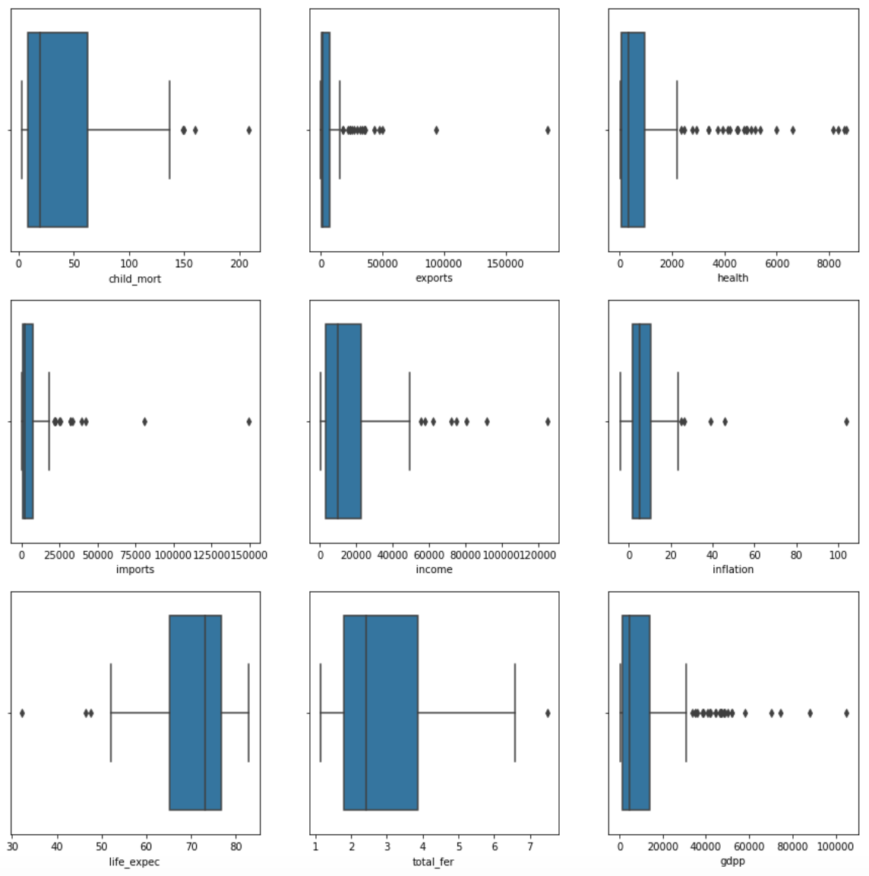
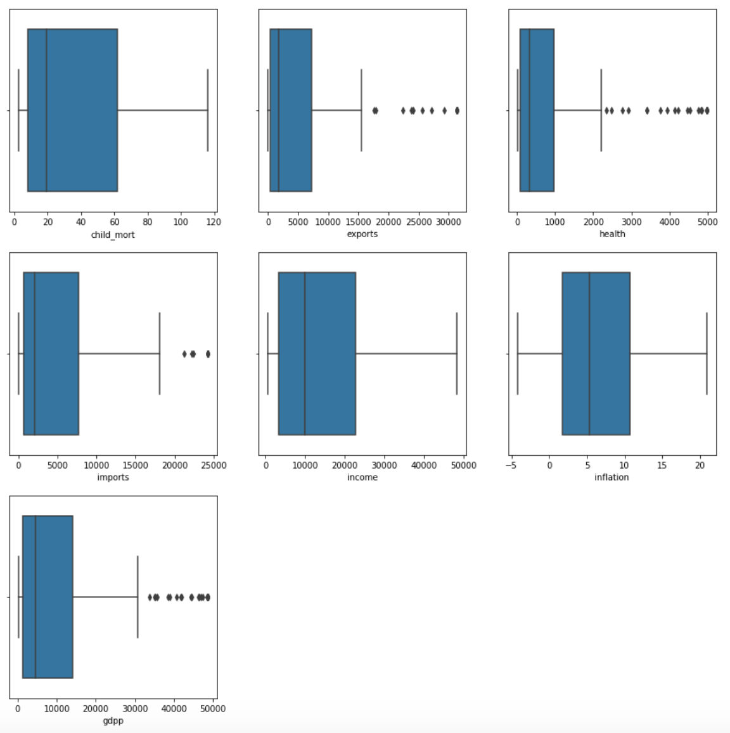
EDA & OUTLIER HANDLING
Analyse Missing values
Update exports, health and imports as their true values followed by a distribution plot for all the attributes
Outlier Handling
Capping the outliers with the feature’s 95th quantile value, only for the higher end entries.
Scaling of data
Standard Scaler was used to scale the features of the data set
Executing Hopkins Test
Hopkins test was used to check the cluster tendency of the data set
With a value of 85 for the Hopkins Test it is clear that the data set is suitable for clustering using the below algorithms
Kmeans
Hierarchical
Before Outlier Handling
After Outlier Handling

Slide 5
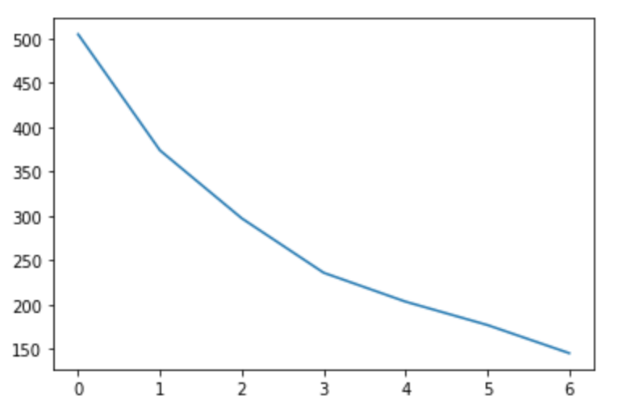
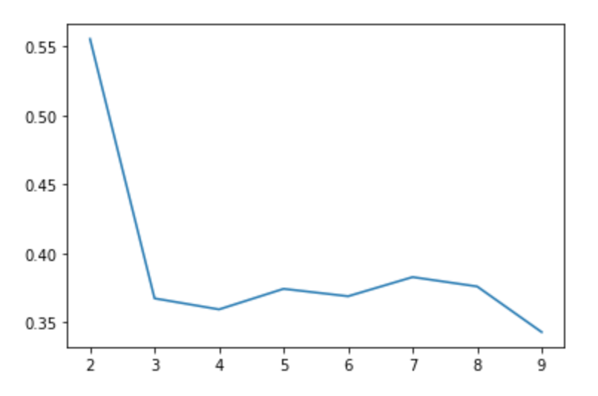
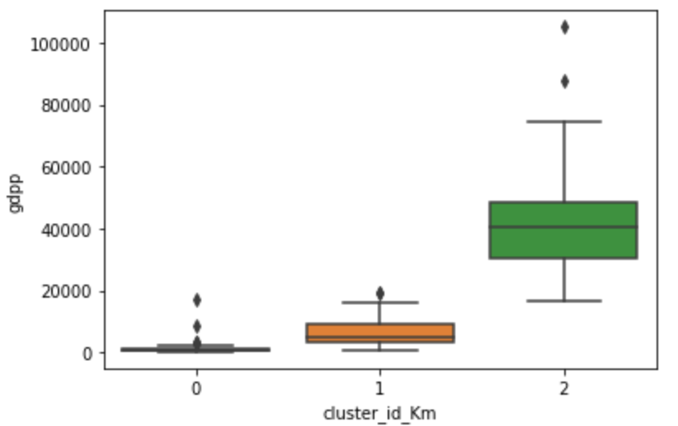
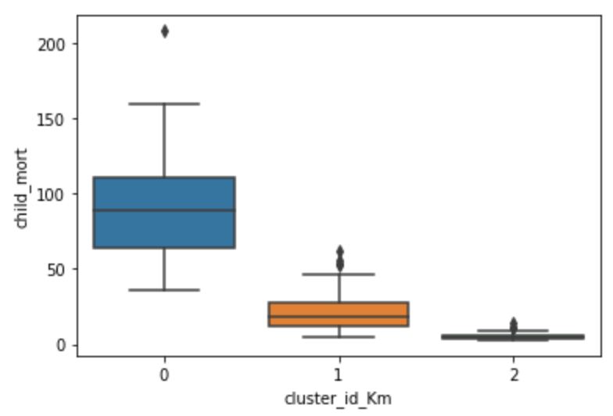
KMEANS CLUSTERING
To define the number of clusters, we used the elbow curve as well as the silhouette analysis which gave us n=3
The number of countries in the clusters formed are as follows 0 - 49 1 - 37 2 - 81
The Univariate analysis on clusters shows us the following observations.
The GDPP of 37 countries belonging to Cluster 1 have the highest gdpp whereas the GDP of 49 countries belonging to Cluster 0 have the lowest gdpp amongst all countries of the dataset.
The Child mortality rate of 49 country belonging to Cluster 0 have the highest Child mortality rate amongst all countries of the dataset.
Elbow Curve
Silhouette Curve

Slide 6
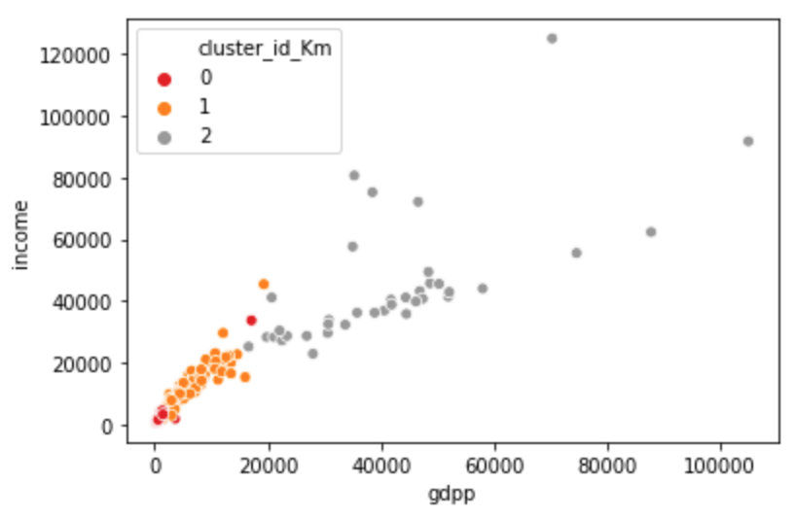
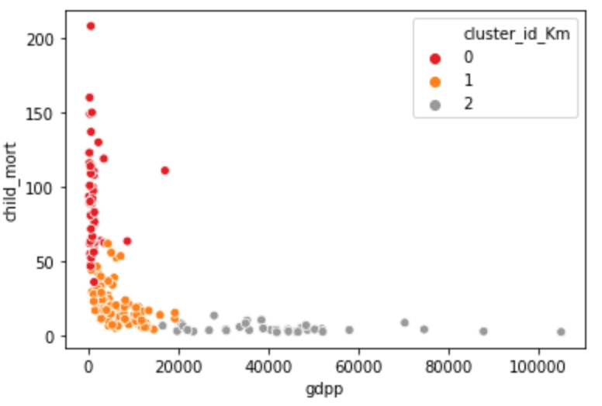
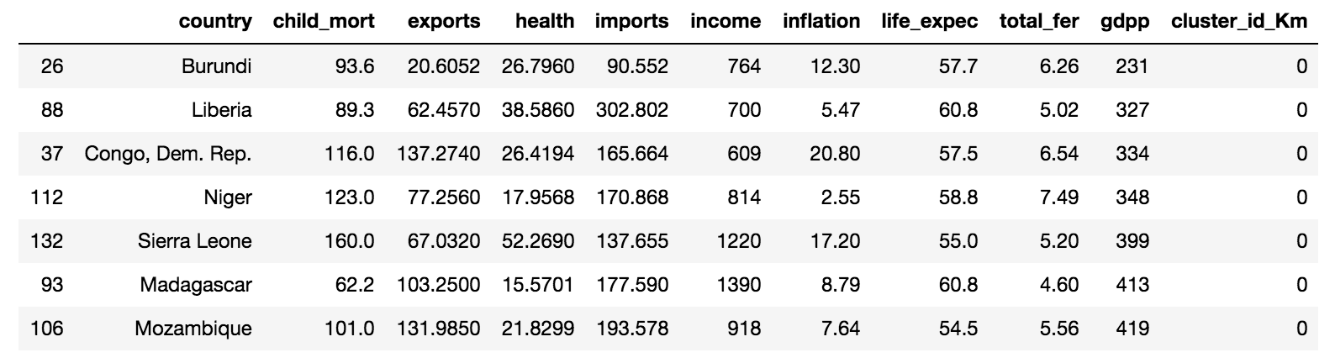
KMEANS CLUSTERING
On further analysis based on cluster profiling, countries in cluster ‘zero’ seemed to be suffering the most due to low income, gdpp along with a high child mortality rate.
Cluster 0 has the least income and gdpp whereas cluster 1 has good high income and gdpp
Cluster 0 has high child_mort and Cluster 1 has high gdpp and low child_mort
After sorting, the countries on ‘low gdpp’, ‘low income’ and ‘high child_mort’, we got the final set of countries which are in dire need of aid and require the immediate attention of the CEO.
Burundi - Liberia – Congo Dem. Rep. - Niger - Sierra Leone - Madagascar - Mozambique

Slide 7
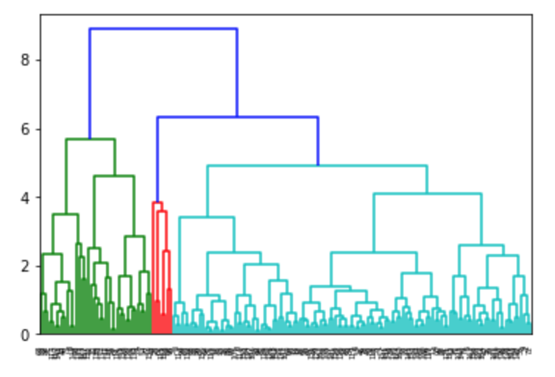
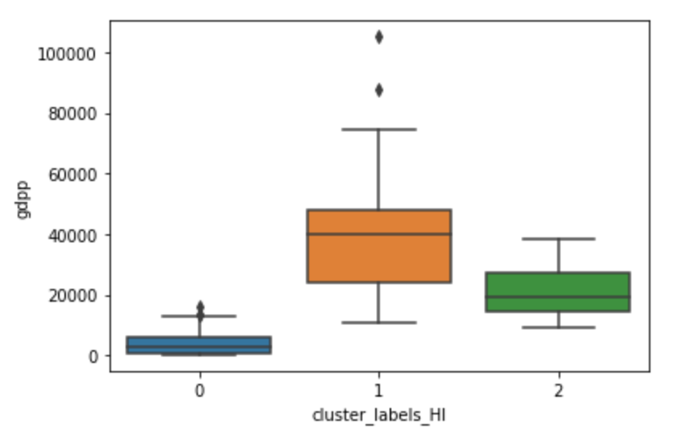
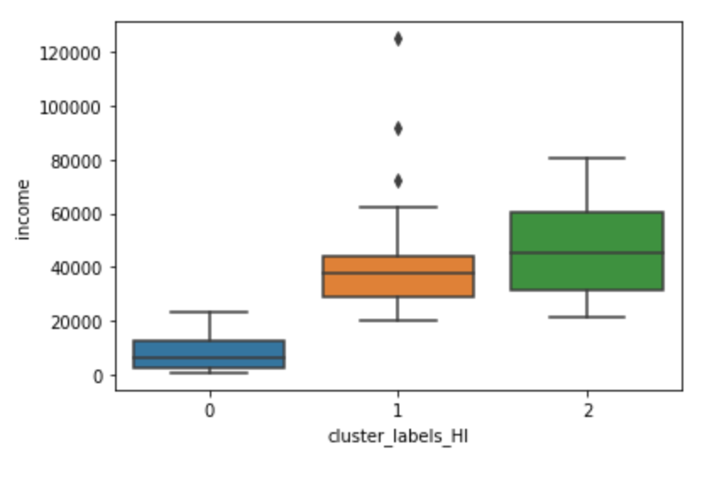
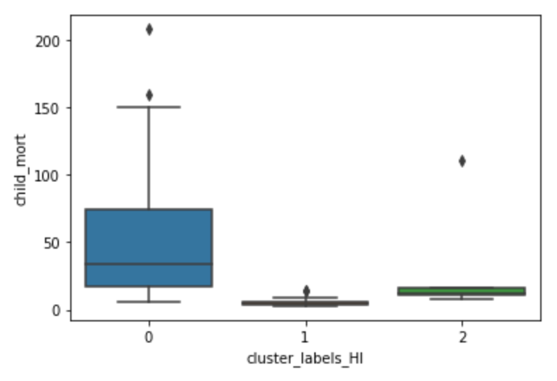
HIERARCHICAL CLUSTERING
Complete linkage Dendogram was used for clustering with n=3
The number of countries in the clusters formed are as follows 0 - 122 1 - 38 2 - 7
The Univariate analysis on clusters shows us the following observations.
The GDPP of 38 countries belonging to Cluster 1 have the highest gdpp whereas the GDP of 122 countries belonging to Cluster 0 have the lowest gdpp amongst all countries of the dataset.
The Income of 7 country belonging to Cluster 2 has the highest Income whereas the Income of 122 countries belonging to Cluster 1 have the lowest Income amongst all countries of the dataset.
The Child mortality rate of 122 country belonging to Cluster 0 have the highest Child mortality rate amongst all countries of the dataset.

Slide 8
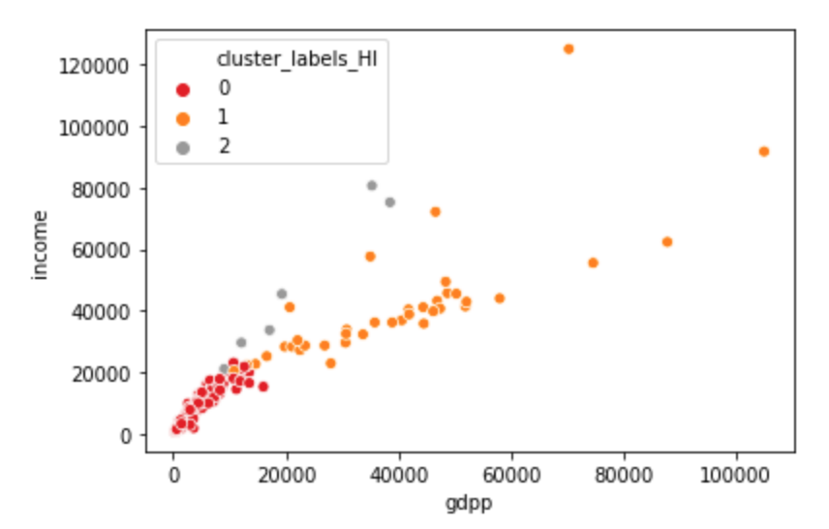
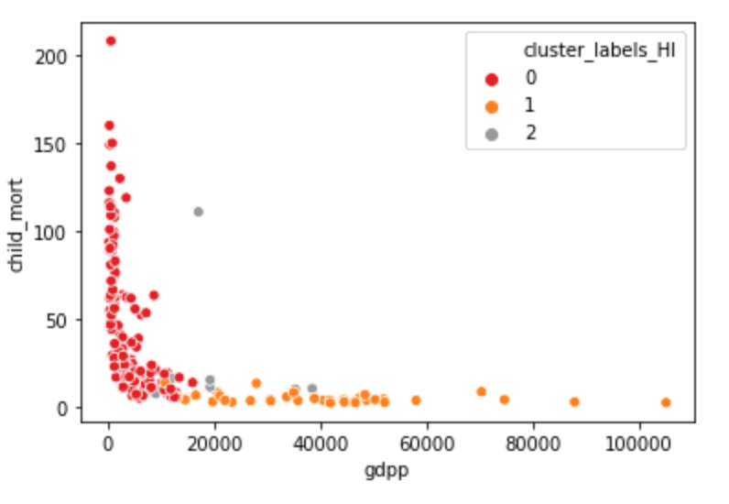
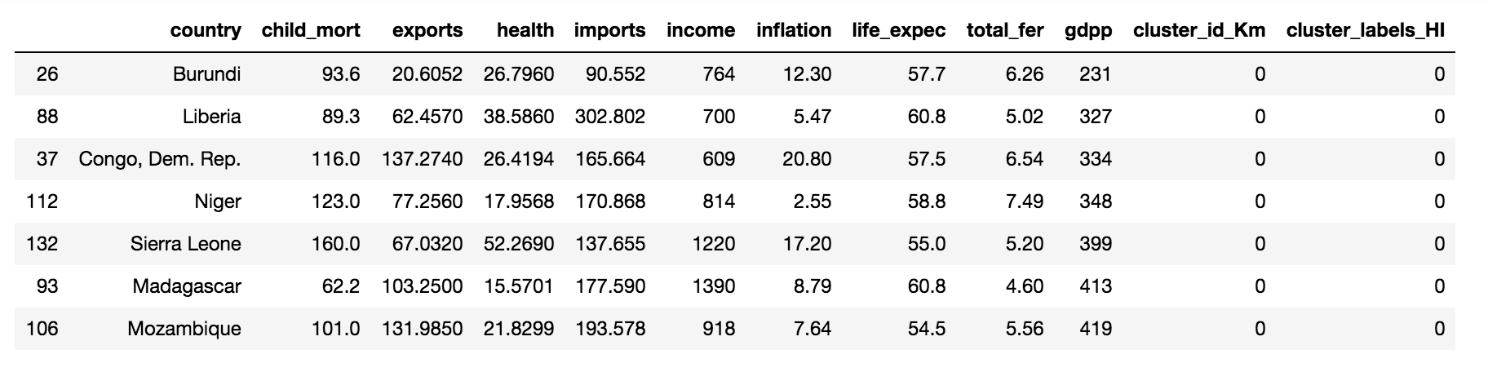
HIERARCHICAL CLUSTERING
On further analysis based on cluster profiling, countries in cluster ‘zero’ seemed to be suffering the most due to low income, gdpp along with a high child mortality rate.
Cluster 0 has the least income and gdpp whereas cluster 1 has good high income and gdpp
Cluster 0 has high child_mort and Cluster 1 has high gdpp and low child_mort
After sorting, the countries on ‘low gdpp’, ‘low income’ and ‘high child_mort’, we got the final set of countries which are in dire need of aid and require the immediate attention of the CEO.
Burundi - Liberia – Congo Dem. Rep. - Niger - Sierra Leone - Madagascar - Mozambique

Slide 9
Conclusion
As both Kmeans and Hierarchical Clustering give the same results we conclude that the below seven countries are in dire need of aid and CEO’s immediate attention.
Burundi
Liberia
Congo Dem. Rep.
Niger
Sierra Leone
Madagascar
Mozambique

